Slide 1
Programming Tools (Lec 1d)
KARATINA UNIVERSITY
P Kariuki
memekariuki@gmail.com

Slide 2
Programming Tools
Flowcharts
Pseudocode
Hierarchy Chart
Direction of Numbered NYC Streets Algorithm
Class Average Algorithm

Slide 3
Flowcharts and Pseudocode

Slide 4
Programming Tools
Three tools are used to convert algorithms into computer programs:
Flowchart - Graphically depicts the logical steps to carry out a task and shows how the steps relate to each other.
Pseudocode - Uses English-like phrases with some Visual Basic terms to outline the program.

Slide 5
Problem solving example
How many stamps do you use when mailing a letter?
One rule of thumb is to use one stamp for every five sheets of paper or fraction thereof.

Slide 6
Algorithm
1. Request the number of sheets of paper; call it Sheets. (input)
2. Divide Sheets by 5. (processing)
3. Round the quotient up to the next highest whole number; call it Stamps. (processing)
4. Reply with the number Stamps. (output)

Slide 7
Flowcharts
Graphically depict the logical steps to carry out a task and show how the steps relate to each other.

Slide 8
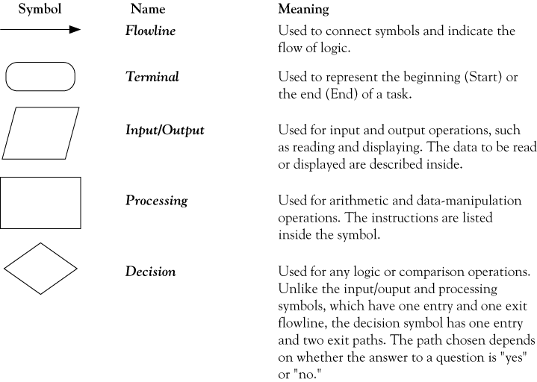
Flowchart symbols

Slide 9
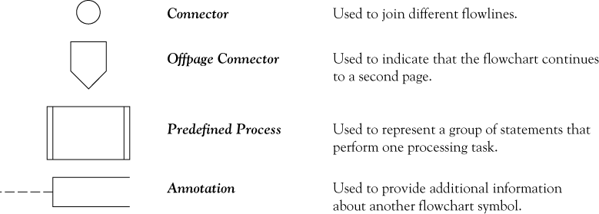
Flowchart symbols continued

Slide 10
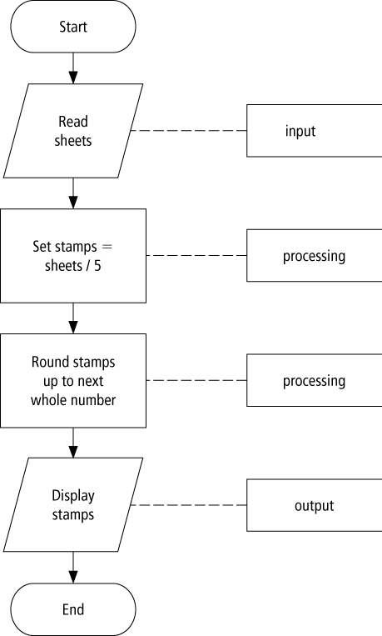
Flowchart example

Slide 11
Pseudocode
Uses English-like phrases to outline the task.

Slide 12
Pseudocode example
Determine the proper number of stamps for a
letter
Read Sheets (input)
Set the number of stamps to Sheets / 5 (processing)
Round the number of stamps up to the next
whole number (processing)
Display the number of stamps (output)

Slide 13
Divide-and-conquer method
Used in problem solving – take a large problem and break it into smaller problems solving the small ones first
Breaks a problem down into modules

Slide 14
Statement structures
Sequence – follow instructions from one line to the next without skipping over any lines
Decision - if the answer to a question is “Yes” then one group of instructions is executed. If the answer is “No,” then another is executed
Looping – a series of instructions are executed over and over

Slide 15
Sequence flow chart

Slide 16
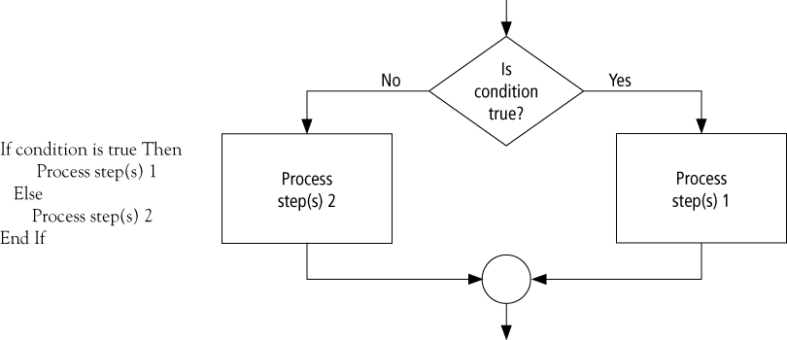
Decision flow chart

Slide 17
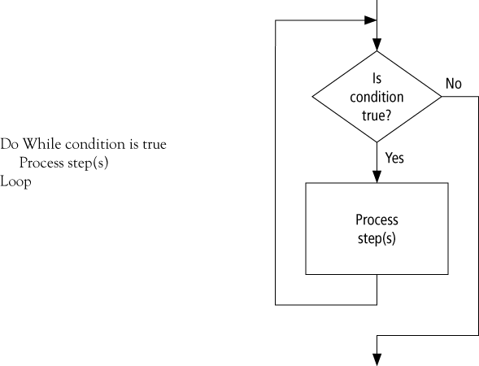
Looping flow chart

Slide 18
Direction of Numbered NYC Streets Algorithm
Problem: Given a street number of a one-way street in New York City, decide the direction of the street, either eastbound or westbound
Discussion: in New York City even numbered streets are Eastbound, odd numbered streets are Westbound

Slide 19
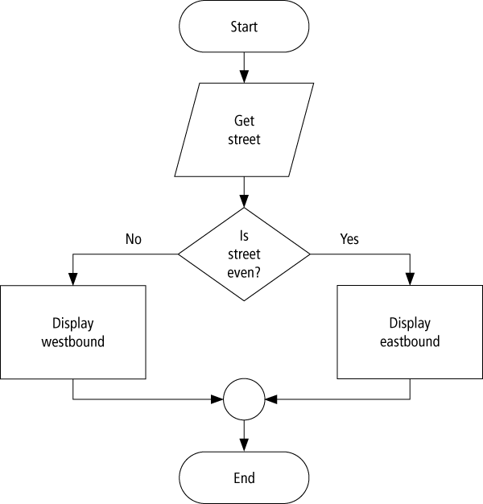
Flowchart

Slide 20
Pseudocode
Program: Determine the direction of a numbered NYC street
Get street
If street is even Then
Display Eastbound
Else
Display Westbound
End If

Slide 21
Class Average Algorithm
Problem: Calculate and report the grade-point average for a class
Discussion: The average grade equals the sum of all grades divided by the number of students
Output: Average grade
Input: Student grades
Processing: Find the sum of the grades; count the number of students; calculate average
Notes:
We need a loop to read and then add (accumulate) the grades for each student in the class. Inside the loop, we also need to total (count) the number of students in the class. See Figures 2.8 to 2.10.
grade = sum of grades / number of students.

Slide 22
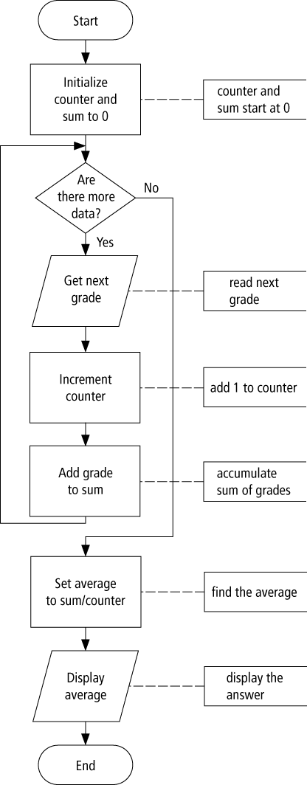
Flowchart

Slide 23
Pseudocode
Program: Determine the average grade of a class
Initialize Counter and Sum to 0
Do While there are more data
Get the next Grade
Add the Grade to the Sum
Increment the Counter
Loop
Computer Average = Sum / Counter
Display Average

Slide 24
Tips and tricks of flowcharts
Flowcharts are time-consuming to write and difficult to update
For this reason, professional programmers are more likely to favor pseudocode and hierarchy charts
Because flowcharts so clearly illustrate the logical flow of programming techniques, they are a valuable tool in the education of programmers

Slide 25
Tips and tricks of pseudocode
There are many styles of pseudocode
Some programmers use an outline form
Some use a form that looks almost like a programming language
The pseudocode in the case studies of this text focus on the primary tasks to be performed by the program and leaves many of the routine details to be completed during the coding process

Slide 26
URL’s for free Flowcharting software
www.smartdraw.com
www.gliffy.com/uses/flowchart-software/
www.breezetree.com/flowcharting-software/
Flowchart Software, FREE Flowchart Examples and Templates ...
www.edrawsoft.com/flowchart.php

